Slide 1
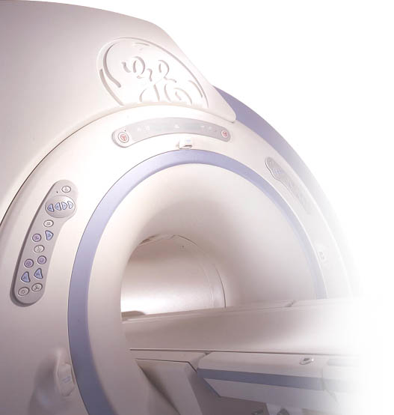

Basic Data Processing with MATLAB®
Ralph Noeske, Ph.D.
Applied Science Laboratory, Europe

Slide 2
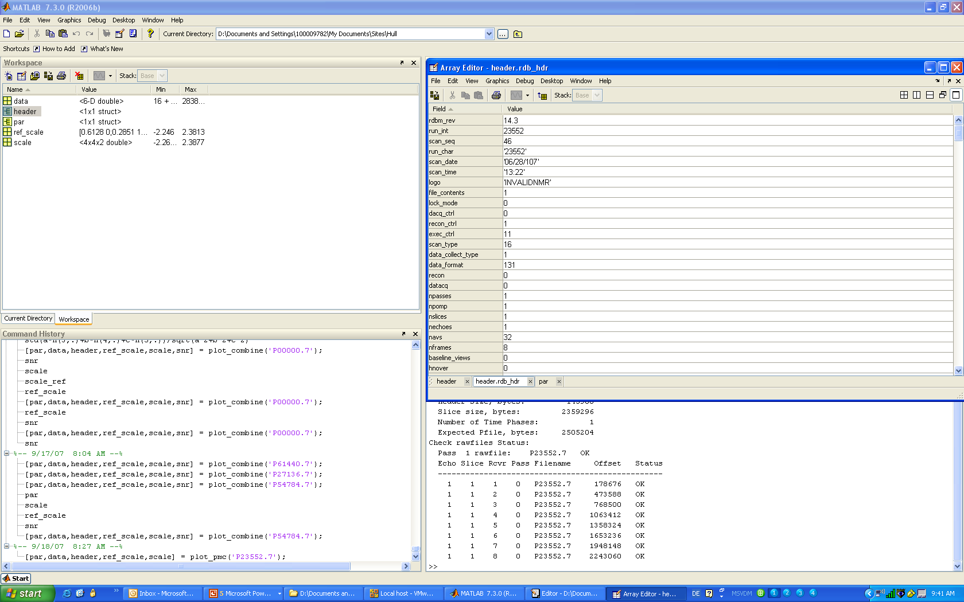
What is MATLAB®
High-level language
Interactive environment

Slide 3
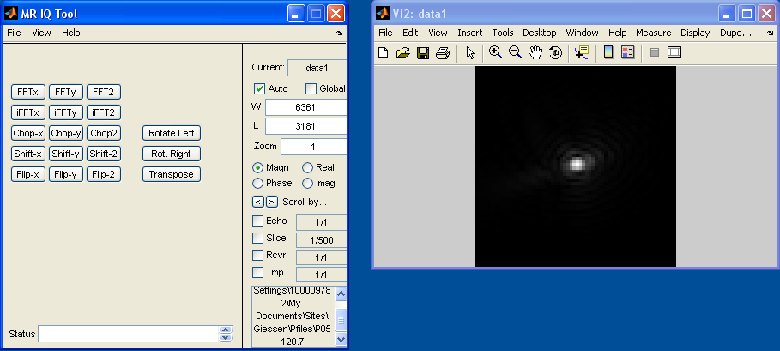
Why MATLAB®
Fast implementation of new post-processing functions by using
existing toolboxes, code from other people, …
Fast visualization
Option: standalone program with MATLAB® compiler

Slide 4
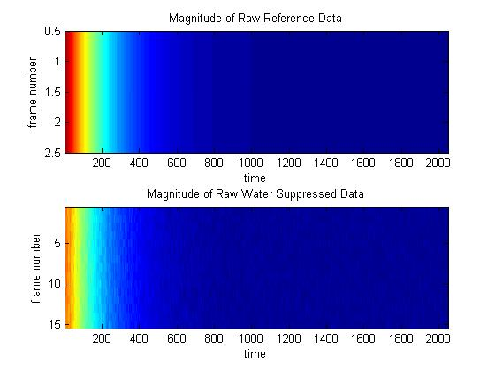
Reading Raw Data Files (Pfiles)
Pfile headers: depend on software version of scanner
include files: rdbm.h, imagedb.h
Use m-file from Fred Frigo: sraw_image.m or plotp.m http://home.wi.rr.com/frigo/

Slide 5
sraw_image.m
% Determine size of Pfile header based on Rev number
status = fseek(fid, 0, 'bof');
[f_hdr_value, count] = fread(fid, 1, 'real*4');
rdbm_rev_num = f_hdr_value(1);
if( rdbm_rev_num == 7.0 )
pfile_header_size = 39984; % LX
elseif ( rdbm_rev_num == 8.0 )
pfile_header_size = 60464; % Cardiac / MGD
elseif (( rdbm_rev_num > 5.0 ) && (rdbm_rev_num < 6.0))
pfile_header_size = 39940; % Signa 5.5
else
% In 11.0 (ME2) the header and data are stored as little-endian
fclose(fid);
fid = fopen(pfile,'r', 'ieee-le');
status = fseek(fid, 0, 'bof');
[f_hdr_value, count] = fread(fid, 1, 'real*4');
if (f_hdr_value == 9.0)
pfile_header_size= 61464;
elseif (f_hdr_value == 11.0)
pfile_header_size= 66072;
elseif (f_hdr_value > 11.0) & (f_hdr_value < 100.0) % 14.0 and later
status = fseek(fid, 1468, 'bof');
pfile_header_size = fread(fid,1,'integer*4');
else
err_msg = sprintf('Invalid Pfile header revision: %f', f_hdr_value )
return;
end
end

Slide 6
sraw_image.m
% Read header information
[hdr_value, count] = fread(fid, 5122, 'integer*2');
nechoes = hdr_value(36);
nframes = hdr_value(38)
point_size = hdr_value(42);
da_xres = hdr_value(52);
da_yres = hdr_value(53);
rc_xres = hdr_value(54);
rc_yres = hdr_value(55);
start_recv = hdr_value(101);
stop_recv = hdr_value(102);
nreceivers = (stop_recv - start_recv) + 1;
slices_in_pass = hdr_value(5122);
% Read 'user19' CV - number of reference frames
status = fseek(fid, 0, 'bof');
[f_hdr_value, count] = fread(fid, 74, 'real*4');
rdbm_rev_num = f_hdr_value(1);
num_ref_frames = f_hdr_value(74)
% Compute size (in bytes) of each frame, echo and slice
data_elements = da_xres*2*(da_yres-1);
frame_size = da_xres*2*point_size;
echo_size = frame_size*da_yres;
slice_size = echo_size*nechoes;
mslice_size = slice_size*nreceivers;

Slide 7
sraw_image.m
% Compute offset in bytes to start of frame. (skip baseline view)
file_offset = pfile_header_size + ((my_slice - 1)*mslice_size) + ...
+ ((my_receiver -1)*slice_size) + ...
+ ((my_echo-1)*echo_size) + ...
+ (frame_size);
status = fseek(fid, file_offset, 'bof');
% read data: point_size = 2 means 16 bit data, point_size = 4 means EDR )
if (point_size == 2 )
[raw_data, count] = fread(fid, data_elements, 'integer*2');
else
[raw_data, count] = fread(fid, data_elements, 'integer*4');
end
%frame_data = zeros(da_xres);
for j = 1:(da_yres -1)
row_offset = (j-1)*da_xres*2;
for m = 1:da_xres
frame_data(j,m) = raw_data( ((2*m)-1) + row_offset) + i*raw_data((2*m) + row_offset);
end
end

Slide 8
sraw_image.m
figure(k);
subplot(2,1,1);
imagesc( abs(frame_data([1:num_ref_frames],:) ));
title('Magnitude of Raw Reference Data');
xlabel('time');
ylabel('frame number');
subplot(2,1,2);
imagesc( abs(frame_data([num_ref_frames+1:nframes-1],:)));
title('Magnitude of Raw Water Suppressed Data');
xlabel('time');
ylabel('frame number');

Slide 9
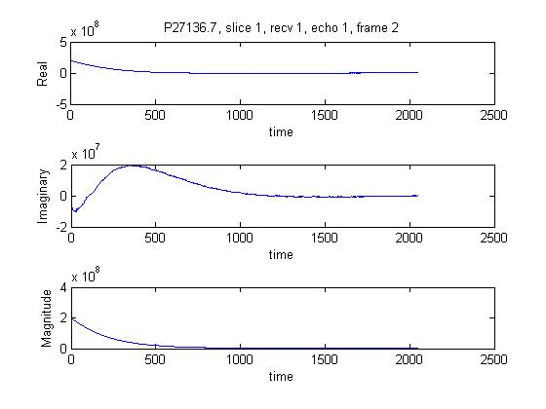
plotp.m
figure(k);
subplot(3,1,1);
plot(real(frame_data));
title(sprintf('%s, slice %d, recv %d, echo %d, frame %d', fname, my_slice, my_receiver, my_echo, my_frame));
%title('Reference data');
xlabel('time');
ylabel('Real');
subplot(3,1,2);
plot(imag(frame_data));
%title(sprintf('Imaginary Data'));
xlabel('time');
ylabel('Imaginary');
subplot(3,1,3);
plot(abs(frame_data));
%title(sprintf('Magnitude Data'));
xlabel('time');
ylabel('Magnitude');

Slide 10

GE toolbox
MR Spectroscopy Processing Class
Pasadena, 23rd & 24th of September 2007

Slide 11
read_MR_rawdata.m
----------------------------------------------------------------
Read MR rawdata files (P-files) copied from Signa. The tool
suppports rawdata files with multiple temporal phases, echos,
slices, and receivers.
[A, HEADER] = read_MR_rawdata(FILENAME); returns the
MR rawdata in FILENAME into A, and returns the headers
into HEADER. Array A may be up to 6-D, with dimensions of
(ky, kx, phase, echo, slice, rcvr).
A = read_MR_rawdata(FILENAME); returns the rawdata into A;
since the headers are not returned, execution is much faster.
A = read_MR_rawdata(FILENAME, BASELINE_FLAG, PHASE, ECHO, SLICE, RCVR);
returns the rawdata into A, using the chosen echo, slice and rcvr.
PHASE, ECHO, SLICE, and RCVR can be a single value or a range of values.
The BASELINE_FLAG must be either 'sb' for "save baseline" or 'db' for
"discard baseline".
If the rawfile contains only one image worth of rawdata, or if only one
phase, echo, slice, and receiver is requested, the returned matrix A will be 2-D.
The index order of the returned matrix will be:
[YRES XRES PHASES ECHOES SLICES RECEIVERS]
Rev 2.3 2003-MAY-29 Matthew Eash. "Initial version"
Rev 2.4 2003-DEC-17 Steve Huff. "Added Multi Temporal Phase Capablity."
Rev 2.5 2004-FEB-25 Steve Huff. "Numerous updates for specifying ranges."
Rev 2.6 2004-MAR=01 Steve Huff. "Added non-standard P file reading and
spead up stripping of extra views for fMRI".
-------------------------------------------------------------------------

Slide 12
read_MR_rawdata.m
par.samples = h.rdb_hdr.frame_size; % sampling points
par.sample_frequency = h.rdb_hdr.spectral_width; % sampling freq
par.offset_frequency = h.rdb_hdr.default_offset; % offset freq
par.synthesizer_frequency = h.rdb_hdr.ps_mps_freq/10; % f0=B0*gamma/2/pi
par.echo_time = h.rdb_hdr.te/1d3; % echo time
par.averages = h.rdb_hdr.user4/h.rdb_hdr.navs; % averages per phase cycle
par.receivers = (h.rdb_hdr.dab(2)-h.rdb_hdr.dab(1))+1; % receiver channels
par.phase_cycling = h.rdb_hdr.navs; % excitations per phase cycle
par.ref_rows = h.rdb_hdr.user19; % First nx-rows: ref scan
par.rows = h.rdb_hdr.nframes-par.ref_rows; % actual frames
[data,header] = read_MR_rawdata(fname);
par = header2par(header);
if (par.ref_rows > 0)
[ref_scale] = coil_scale_simple(data, par);
end
fid_raw = zeros(par.rows, par.samples);
for r=1:par.receivers
fid = ref_scale(r,1) * exp(i * ref_scale(r,2)) * data(par.ref_rows+1:par.ref_rows+par.rows,:,1,1,1,r);
for k=1:par.rows
fid_raw(k,:) = fid_raw(k,:) + fid(k,:);
end
end
header =
endian: 'ieee-le'
format: 'pfile14.3'
rdb_hdr: [1x1 struct]
data_acq_tab: [1x1 struct]
exam: [1x1 struct]
series: [1x1 struct]
image: [1x1 struct]
total_length: 145908

Slide 13
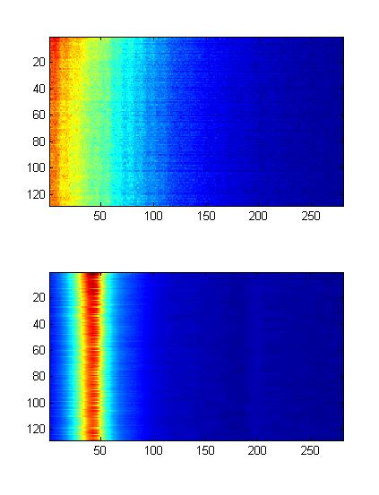
read_MR_rawdata.m
fid_ft = fftshift(fft(fid_raw,[],2),2);
fid_center = par.samples/2 + 1;
figure(1);
subplot(2,1,1);
imagesc(abs(fid_raw(:,1:280)));
subplot(2,1,2);
imagesc(abs(fid_ft(:,fid_center-40:fid_center+240)));

Slide 14
Thank You
ralph.noeske@ge.com

